Slide 1
CSS: Again
Padding, positioning, and everything in-between.

Slide 2
The Box Model

Slide 3
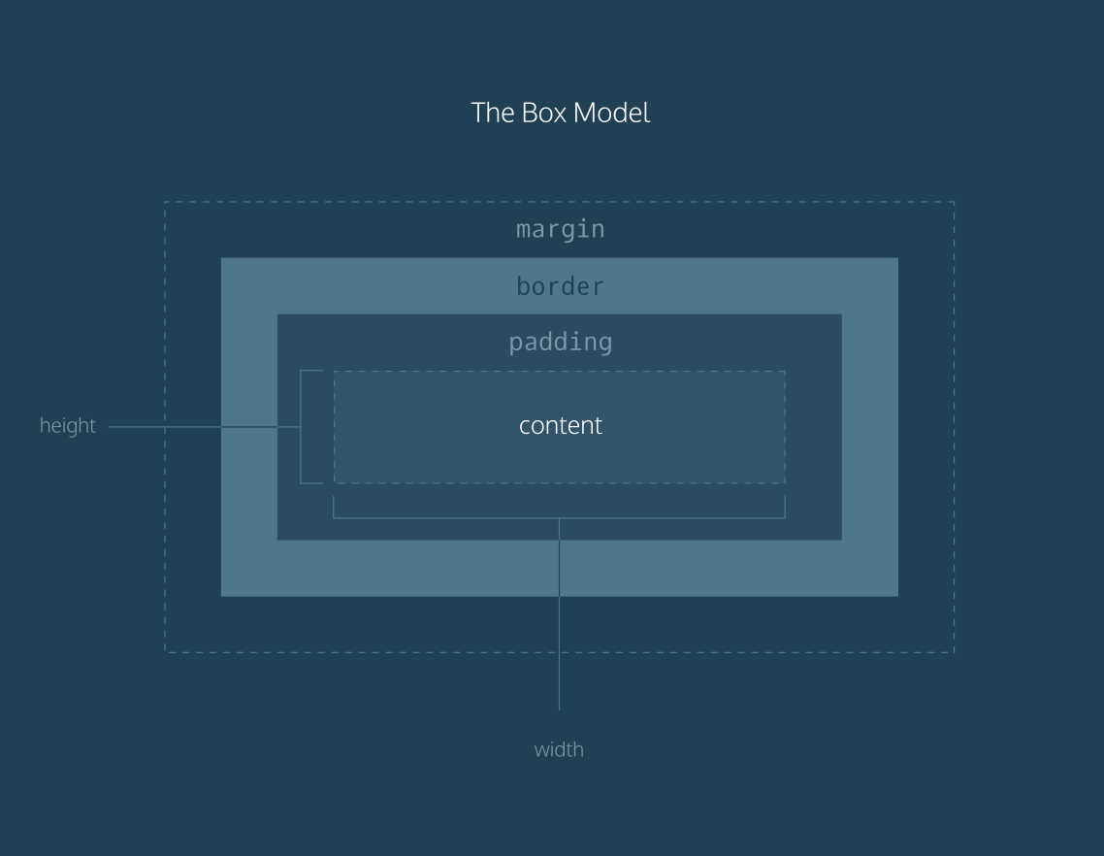
Notes:
Livecode example of each of these dimensions

Slide 4
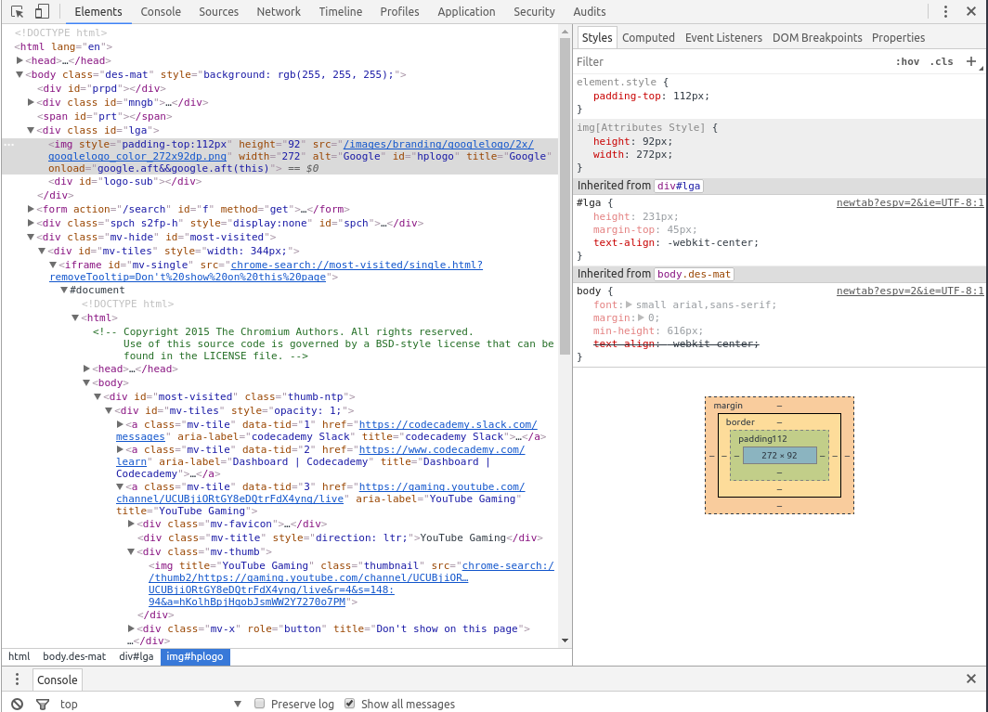
Dev Tools Box Model Inspection

Slide 5
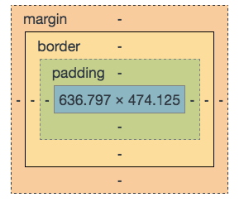
Box Model 📦
Margin
Border
Padding
Content

Slide 6
Border Radius
Doesn’t do anything for inline elements (except for <img>)
Notes:
Livecode example of each of these dimensions

Slide 7
Padding
Padding
Content

Slide 8
Border
Border
Content

Slide 9
Margin
Margin
Border
Padding
Content

Slide 10
Margin Collapse (vertical only)
Border
Padding
Content
Margin Collapse
Margin
Border
Padding
Content

Slide 11
Block
<div>
<h1>
<p>
<li>
<ul>
...and so much more!
Content
Content

Slide 12
In-line
<span>
<a>
<strong>
<code>
...and so much more!
Block’s will sometimes have content.
Inline

Slide 13
Inline-Block
Content
Content

Slide 14
Collapsing Margins
margin-top: 10 px
Vertical margins (-top and -bottom) only
Maximum between adjacent margins used; other is discarded
UNLESS a negative margin is used somewhere, then margins are summed
Rule of thumb: margin-top or margin-bottom, not both
Parent-child margin collapsing: http://codepen.io/team/css-tricks/pen/EjKOdV
margin-bottom: 35 px
margin-bottom: 35 px

Slide 15
The Display Property

Slide 16
Inline, Block, and Inline-Block
This is an
example
of
Block
Inline-block
allows
resizes
how
inline
works
Elements
Are pushy

Slide 17
Inline, Block, and Inline-Block, Continued
Inline elements
respect left & right margins and padding, but not top & bottom
cannot have a width and height set
allow other elements to sit to their left and right. see very important side notes on this here.
Block elements
respect all of those
force a line break after the block element
Inline-block elements
allow other elements to sit to their left and right
respect top & bottom margins and padding
respect height and width
“Oldskool” (http://stackoverflow.com/users/214577/oldskool) on Stackoverflow http://stackoverflow.com/a/9189873

Slide 18
The Position Property

Slide 19
Static
Default value
Ignores top, left, bottom, and right properties

Slide 20
Relative
Top, left, bottom, and right
Doesn’t affect flow of other elements (leaves a space)

Slide 21
Fixed
Unlike relative, no empty space
Relative to the viewport
Moves with you
z-index

Slide 22
Absolute
Positioned from 0, 0 of nearest positioned (not static) parent
No empty space left behind

Slide 23
Q&A

Slide 24
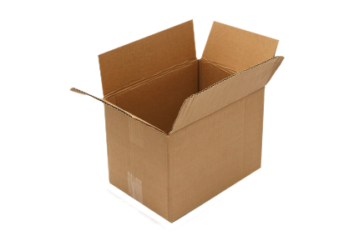
Flexbox - The Most Flexible https://www.w3.org/TR/css-flexbox-1/

Slide 25
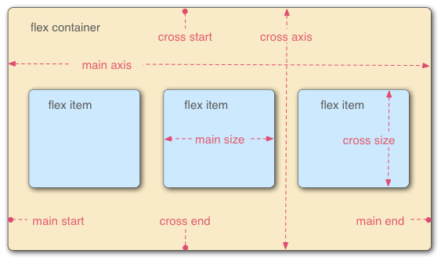
“Flexible Boxes”
Change ordering
Change dimensions
Respond to different window sizes
Major/main and cross axes
flex-direction
Top to bottom? Right to left? You decide!
flex-wrap
When things get tight, squeeze or stack
flex-grow
How much real estate should this element take up?
https://developer.mozilla.org/en-US/docs/Web/CSS/CSS_Flexible_Box_Layout/Using_CSS_flexible_boxes

Slide 26
MORE LINKS. YAY.
http://codepen.io/justd/full/yydezN/
CSS Tricks Guide to Flexbox
Vertical Centering with Flexbox
Block Elements

Slide 27
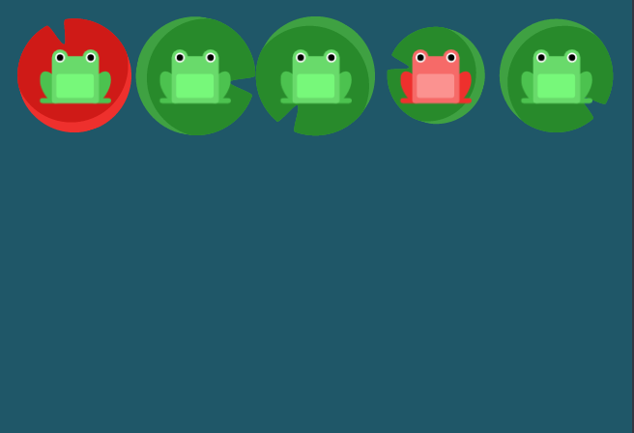
Flexbox Froggy, A great game to learn this stuff.
http://flexboxfroggy.com

Slide 28
Q&A

